Slide 1
Data Structures ICT-1211 Information and Communication Technology
Lecture-27
Date: //2024

Slide 2
Graph

Slide 3
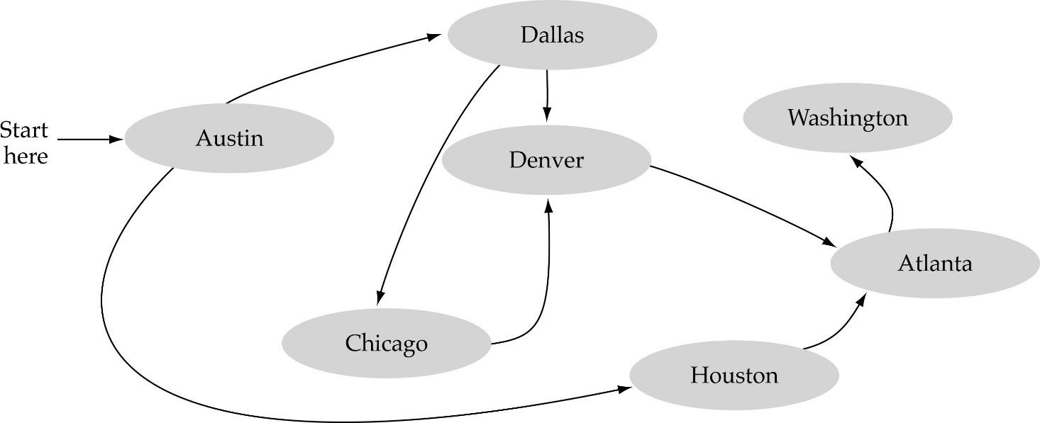
What is a graph?
A data structure that consists of a set of nodes (vertices) and a set of edges that relate the nodes to each other
The set of edges describes relationships among the vertices

Slide 4
What is a graph?
Definition − A graph (denoted as G = (V, E)) consists of a non-empty set of vertices or nodes V and a set of edges E. A vertex a represents an endpoint of an edge. An edge joins two vertices a, b and is represented by set of vertices it connects.

Slide 5
Formal definition of graphs
A graph G is defined as follows:
G=(V,E)
V(G): a finite, nonempty set of vertices
E(G): a set of edges (pairs of vertices)

Slide 6
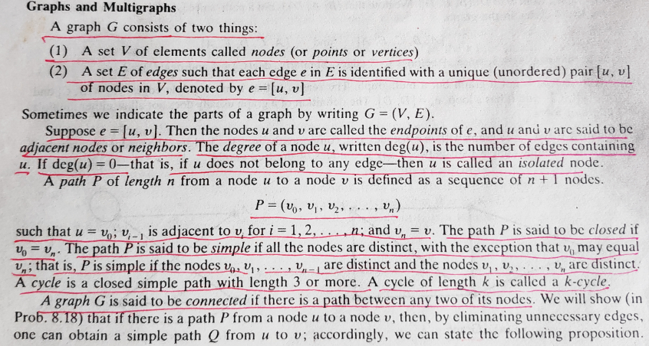
Graphs

Slide 7
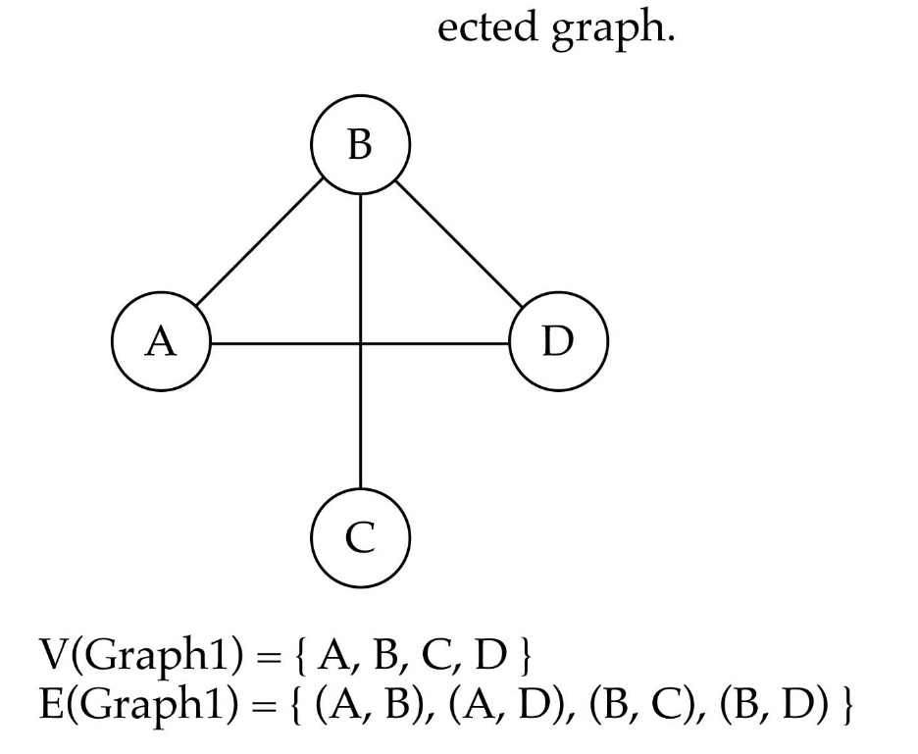
Directed vs. undirected graphs
When the edges in a graph have no direction, the graph is called undirected

Slide 8

Directed vs. undirected graphs (cont.)
When the edges in a graph have a direction, the graph is called directed (or digraph)
Warning: if the graph is directed, the order of the vertices in each edge is important !!
E(Graph2) = {(1,3) (3,1) (5,9) (9,11) (5,7)

Slide 9

Trees vs graphs
Trees are special cases of graphs!!

Slide 10
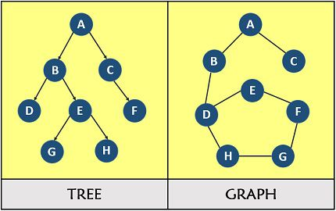
Trees vs graphs
A graph is a group of vertices and edges where an edge connects a pair of vertices whereas a tree is considered as a minimally connected graph which must be connected and free from loops

Slide 11

Graph terminology
Adjacent nodes: two nodes are adjacent if they are connected by an edge
Path: a sequence of vertices that connect two nodes in a graph
Complete graph: a graph in which every vertex is directly connected to every other vertex
5 is adjacent to 7
7 is adjacent from 5

Slide 12
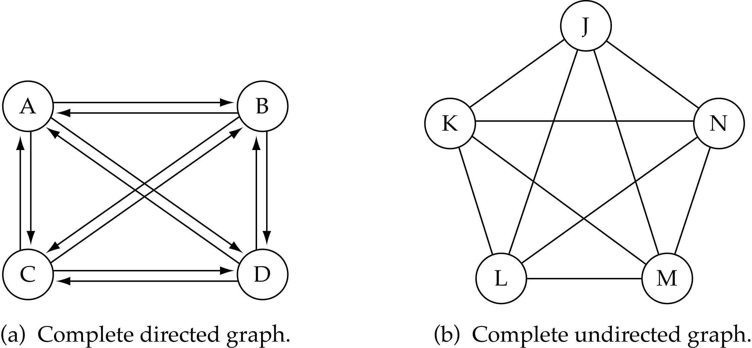
Graph terminology (cont.)
What is the number of edges in a complete directed graph with N vertices?
N * (N-1)

Slide 13
Graph terminology (cont.)
What is the number of edges in a complete undirected graph with N vertices?
N * (N-1) / 2

Slide 14
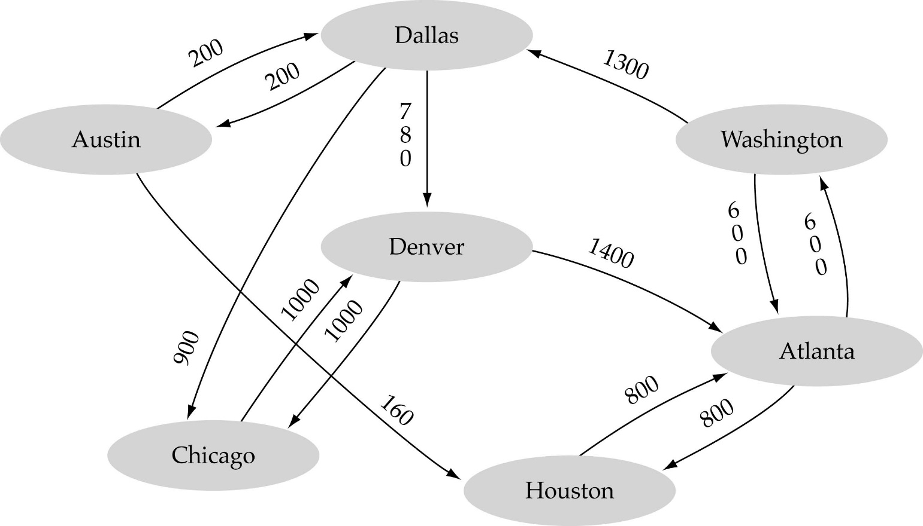
Graph terminology (cont.)
Weighted graph: a graph in which each edge carries a value

Slide 15
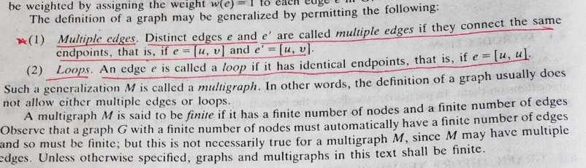
Graphs

Slide 16
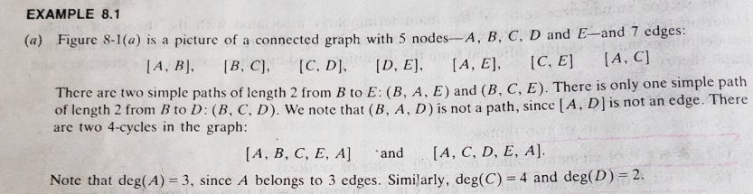
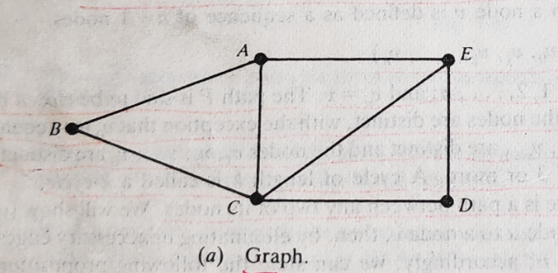
Graphs

Slide 17
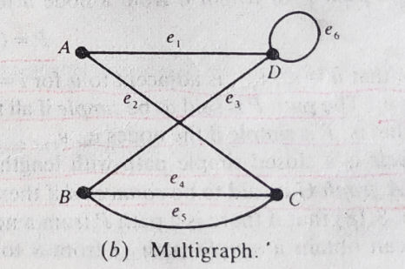
Graphs

Slide 18
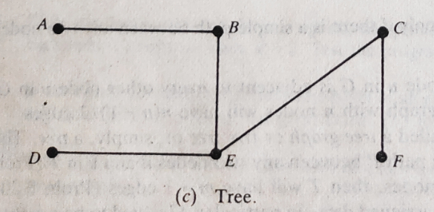
Graphs

Slide 19
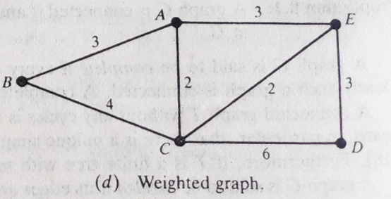
Graphs

Slide 20
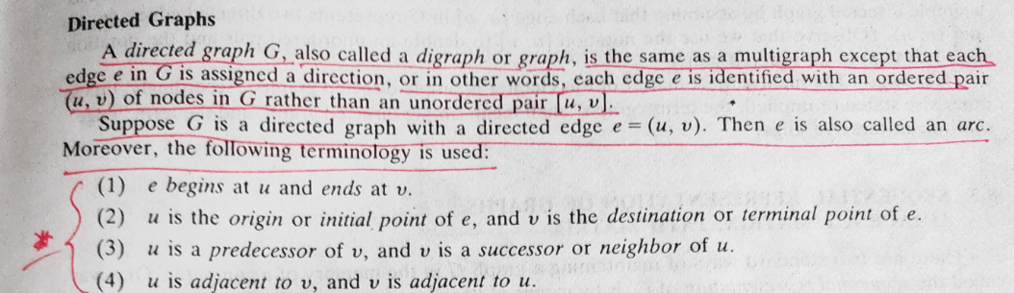
Graphs

Slide 21
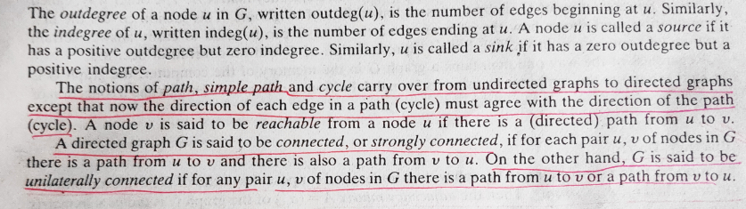
Graphs

Slide 22
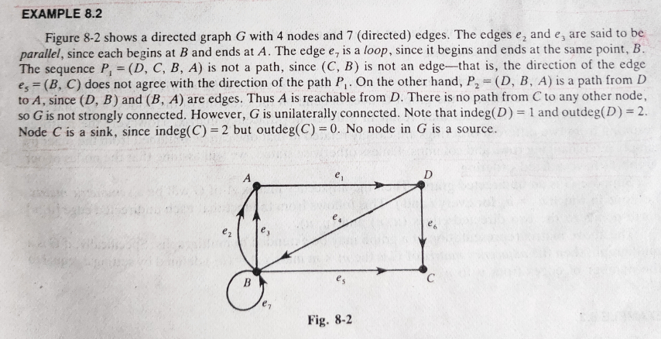
Graphs

Slide 23
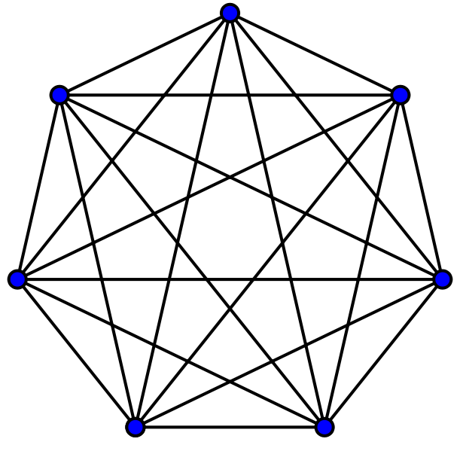
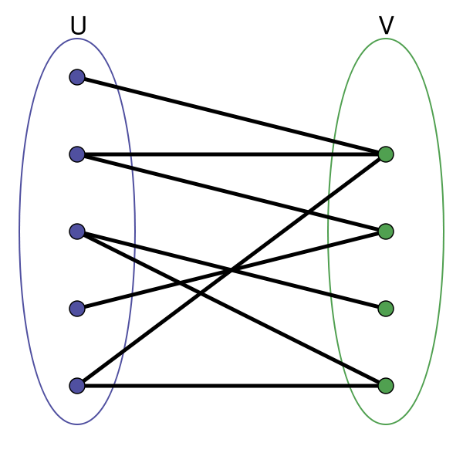
Graph Definitions – types of Graphs
A complete undirected unweighted graph
is one where there is an edge connecting all possible pairs of vertices in a graph. The complete graph with n vertices is denoted as K_{n}.
A graph is bipartite
if there exists a way to partition the set of vertices V, in the graph into two sets V₁ and V₂
where V₁ ∪ V₂ = V and V₁ ∩ V₂ = ∅, such that each edge in E contains one vertex from V₁ and the other vertex from V₂.

Slide 24
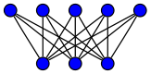
Graph Definitions – types of graphs
Complete bipartite graph
A complete bipartite graph on m and n vertices is denoted by K_{m,n} and consists of m+n vertices, with each of the first m vertices connected to all of the other n vertices, and no other vertices.

Slide 25
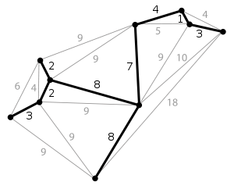
Graph Definitions – graph terms
A path
A path of length n from vertex v₀ to vertex v_{n} is an alternating sequence of n+1 vertices and n edges beginning with vertex v₀ and ending with vertex v_{n} in which edge e_{i} is incident upon vertices v_{i-1} and v_{i}.
(The order in which these are connected matters for a path in a directed graph in the natural way.)
A connected graph
A connected graph is one where any pair of vertices in the graph is connected by at least one path.

Slide 26
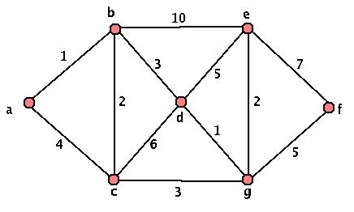
Graph Definitions – types of Graphs
A weighted graph
A weighted graph associates a label (weight) with every edge in the graph.
The weight of a path or the weight of a tree in a weighted graph is the sum of the weights of the selected edges.
The function dist(v,w)
The function dist(v, w), where v and w are two vertices in a graph, is defined as the length of the shortest path from v to w.
dist(b,e) = 8

Slide 27
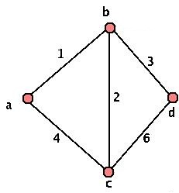
Graph Definitions – types of Graphs
A subgraph
A graph G'= (V', E') is a subgraph of G = (V, E) if V' ⊆ V, E' ⊆ E, and for every edge e' ∈ E', if e' is incident on v' and w', then both of these vertices is contained in V'.

Slide 28
Graph Definitions – types of Graphs
A simple path
A simple path is one that contains no repeated vertices.
6
4
5
1
3
2
A cycle
A path of non-zero length from and to the same vertex with no repeated edges.
A simple cycle
A cycle with no repeated vertices except for the first and last one.
6
4
5
1
3
2

Slide 29
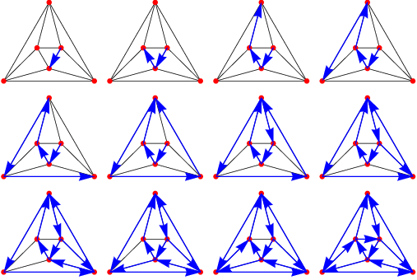
Graph Definitions – types of Graphs
A Hamiltonian cycle
A Hamiltonian cycle is a simple cycle that contains all the vertices in the graph.
4
5
6
1
3
2
A Euler cycle
An Euler cycle is a cycle that contains every edge in the graph exactly once.
Note that a vertex may be contained in an Euler cycle more than once. Typically, these are known as Euler circuits, because a circuit has no repeated edges.

Slide 30
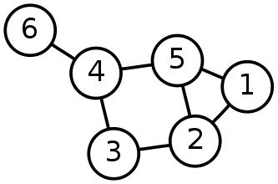
Graph Definitions – types of Graphs
The complement of a graph
The complement of a graph G is a graph G' which contains all the vertices of G, but for each edge that exists in G, it is NOT in G', and for each possible edge NOT in G, it IS in G'.
1
3
5
6
4
2
 | 2 | 3 | 4 | 5 | 6
1 | 1 | 0 | 0 | 1 | 0
2 |  | 1 | 0 | 1 | 0
3 |  |  | 1 | 0 | 0
4 |  |  |  | 1 | 1
5 |  |  |  |  | 0
 | 2 | 3 | 4 | 5 | 6
1 | 0 | 1 | 1 | 0 | 1
2 |  | 0 | 1 | 0 | 1
3 |  |  | 0 | 1 | 1
4 |  |  |  | 0 | 0
5 |  |  |  |  | 1

Slide 31
Thank you……

